Slide 1
VILLAGE OF NORTH HAVEN
4 POSTER PROGRAM
Chris Miller

Slide 2
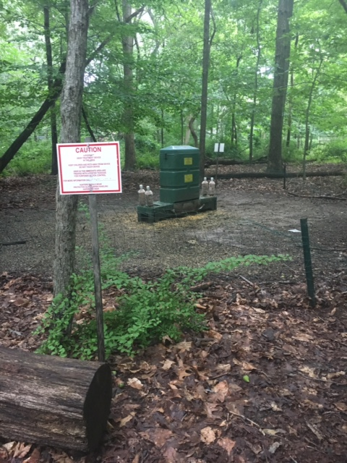
4 POSTER PROGRAM

Slide 3
4 POSTER PROGRAM
NYS DEC: Special Licenses Unit – 4-Poster License
Grants program specific license to ‘Bait White Tailed Deer in Conjunction with 4-Poster Program’ and all conditions; Tick sampling, Deer Management, etc…
Permit and Annual report submitted January
Ideal Deployment April 1st through Mid/End of November

Slide 4
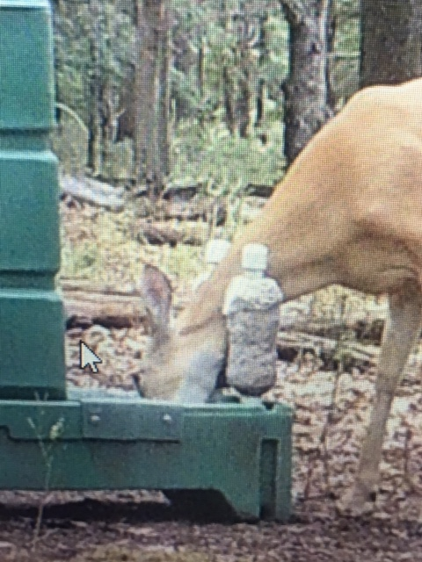
4 POSTER PROGRAM
250 Lbs. Triple Cleaned Corn
Weekly servicing: clean unit, refill with corn, administer Tickicide as per NYS DEC
Periodic Maintenance: Sheet metal guards, New springs, Post Washers, New rollers
All work completed by NYSDEC Certified applicator with specific 4-Poster training and license endorsement

Slide 5
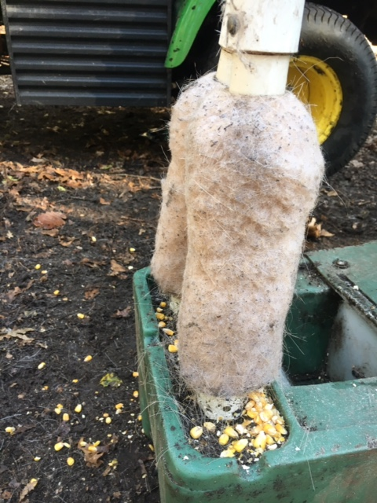
4 POSTER PROGRAM
- Deer feed upon corn
- Ears & Neck contact treated rollers (adult tick locations)
- Adult ticks die on contact

Slide 6
4 POSTER PROGRAM
4 Poster System kills adult ticks which reduces the tick population
Adult engorged females lay thousands eggs

Slide 7
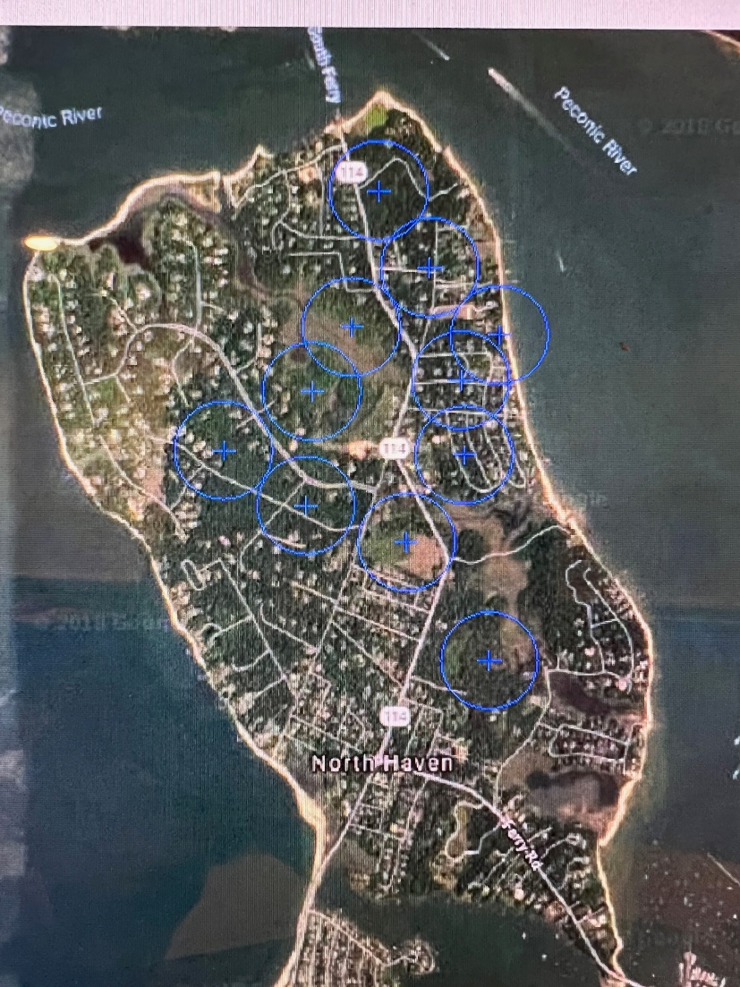
4 POSTER PROGRAM
Deployment History:
2015- 11 units
2016- 12 units
2017- 12 units
2018- 12 units
2019- 17 units
2020- 3 units
2021- 7 units
2015 Deployment

Slide 8
4 POSTER PROGRAM
2020 Challenges
NYS DEC: Special Licenses Unit- 4-Poster Written Consent Rule:
‘Written consent from all specific properties that fall wholly or partially within a radius of 745 feet of each proposed 4-Poster’
*Covid-19 Permit processing delays
Deployment 7/13/2020

Slide 9
4 POSTER PROGRAM
2021 and Future
Early April deployment; Stored end of November
7 units deployed 2021
With additional written consent its possible for another 4-6 deployed units

Slide 10
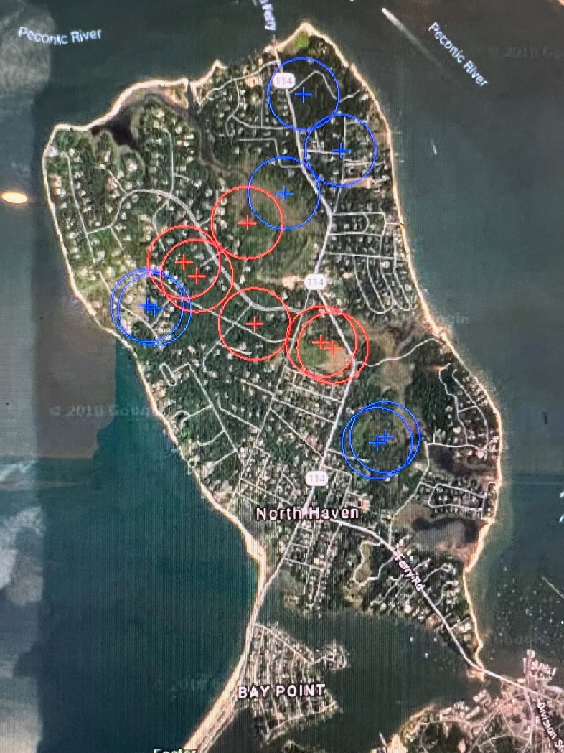
4 POSTER PROGRAM
2021 Deployment
Future Deployment

Slide 11
4 POSTER PROGRAM
Future Considerations:
-Obtain consent for additional 4-6 units; only few required signatures remain
-Early April deployment
-Review future long term potential sites for optimal deployment: NHPT, Manor, County/Goodwood, Robertson/Tyndall & Ferry Road Areas

Slide 12
4 POSTER PROGRAM
Blue: 2021 Deployment
Red: Additional short-term considerations
Yellow: Additional long-term considerations

Slide 13
Chris Miller
Chris Miller Horticulture Specialists, Inc
NYS DEC Certified Applicator
631.375.6901
cmillerhort@gmail.com

